Slide 1
Presentation
Topic: Blockchain and Cryptocurrency
By: Naveed Khan Afridi
Rahmat Ullah Afridi
Muhammad Anas Afridi
Danyal Khattak

Slide 2
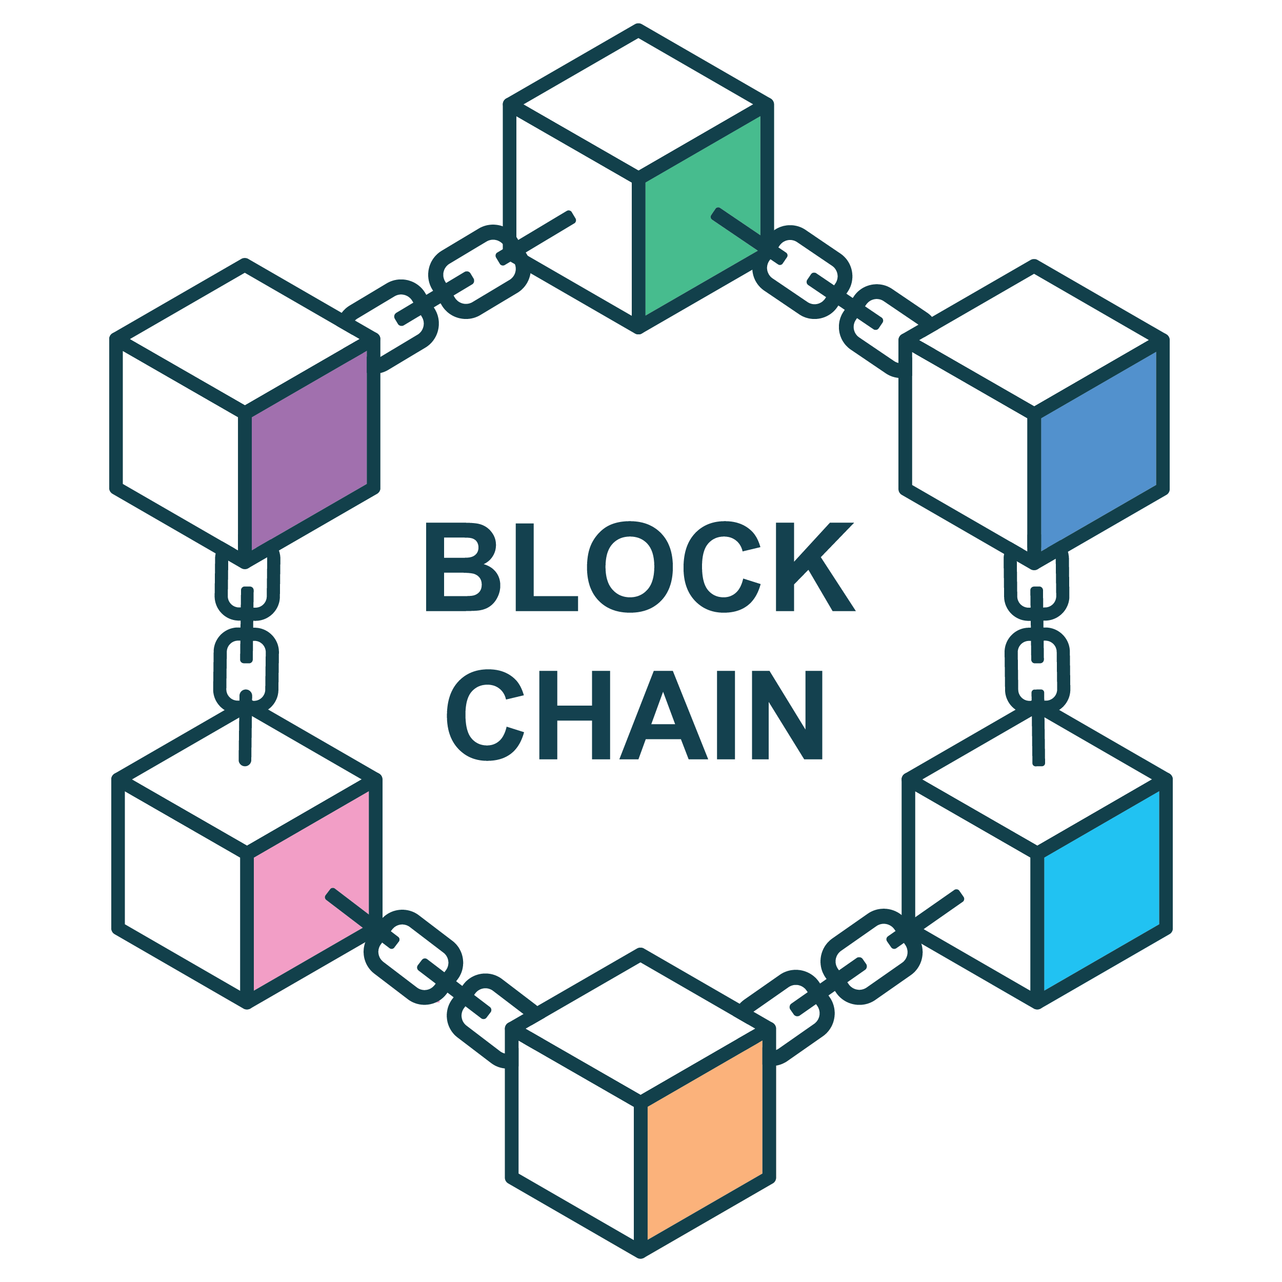
Blockchain:
decentralized digital ledger that records transactions across multiple computers securely.
It records and verifies transactions across multiple computers.
Ensures transparency, security, and immutability.

Slide 3
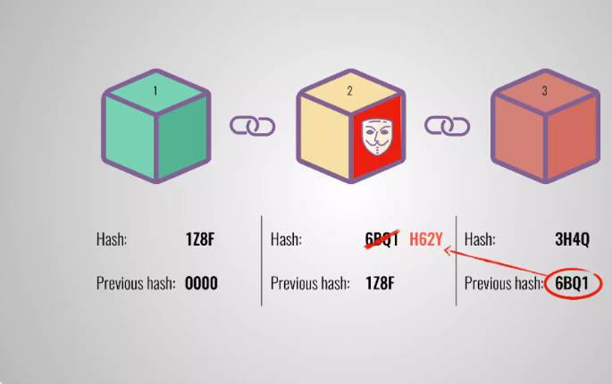
Working Principle of Blockchain
Transactions are grouped into blocks.
Each block is linked to the previous one, forming a chain.
Blocks are verified by a network of nodes, ensuring security.

Slide 4
Core Features:
Decentralization: No central authority.
Transparency: Publicly verifiable transactions.
Immutability: Data cannot be altered once recorded.
Security: Strong encryption protects the data.

Slide 5
Real-World Uses:
Cryptocurrency: Bitcoin, Ethereum.
Supply Chain: Track goods and materials.
Smart Contracts: Self-executing contracts.
Healthcare: Secure patient data sharing.

Slide 6
Pros And Cons of Blockchain
A short Overview of Blockchain’s Advantages and Disadvantages
Key Advantages of Blockchain Technology
1. Data is Immutable:
Data can’t be changed once it's added, making it reliable.
2. Transparency:
Everyone can see the transactions, building trust.

Slide 7
3. Traceability:
You can easily track and check where data comes from.
4. Low Transaction Fees:
It's cheaper than traditional methods
5. Heightened Security:
The system is very secure and hard to hack.

Slide 8
Cons of Blockchain
Challenges and Disadvantages of Blockchain
1. Cost of Implementation:
It’s expensive to set up.
2. Low Performance:
It works slower than other systems.

Slide 9
3. Modifying Data is Hard:
Changing data is difficult once it’s added.
4. Private Key Recovery:
If you lose your key, you lose access to everything.
5. Prone to Illegal Activity:
It can be used for illegal things due to anonymity.

Slide 10
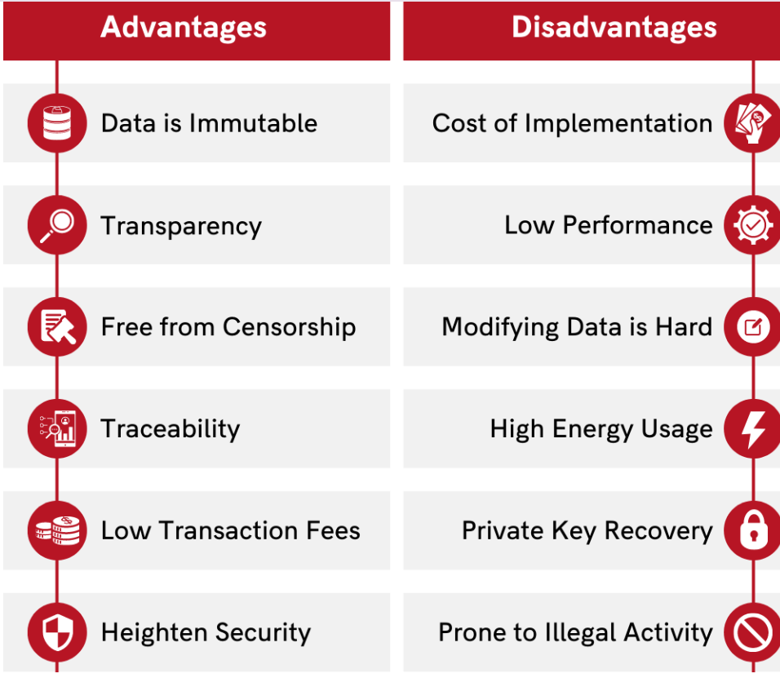
Summary

Slide 11

What is cryptocurrency
A cryptocurrency is a digital or virtual currency that uses cryptography for security. Cryptocurrencies are decentralized, meaning that are not subject to government or financial institutions control.
Cryptocurrency is a digital asset designed to work as a medium of exchange that uses strong cryptology to secure financial transactions.

Slide 12
How Cryptocurrency Works
Decentralized System
Cryptocurrencies use blockchain: a digital ledger to record transactions.
Blockchain Structure
Each block in the chain contains several transactions.
Once a block is completed, it is added to the chain and cannot be altered.
Security and Verification
Transactions are secured and verified through complex algorithms and cryptography.

Slide 13

Bitcoin (BTC)
The first cryptocurrency, created in 2009 by Satoshi Nakamoto.
A digital store of value and alternative investment.
Ethereum (ETH)
A decentralized platform for building smart contracts and decentralized applications (dApps).
Known for its smart contract functionality.
Ripple (XRP)
Focuses on enabling fast, low-cost international money transfers.
Popular among banks and financial institutions.

Slide 14
Advantages and Disadvantages of Cryptocurrency
Advantages of Cryptocurrency
1. Decentralization:
Not controlled by governments or financial institutions.
2. Fast Transactions:
A cryptocurrency transaction is generally a quick and straightforward process. For example, Bitcoins can be transferred from one digital wallet to another, using only a smartphone or computer.

Slide 15
3. Transparency:
All transactions are recorded on a public ledger (blockchain).
4.Low Transaction Costs:
Compared to traditional banking or international transfers, cryptocurrency transactions are faster and often involve minimal fees.

Slide 16
5.Profit Opportunities:
Due to high volatility, cryptocurrencies offer significant profit potential for traders and investors.
6.Ownership Control:
users have complete control over their assets, stored in digital wallets, without relying on intermediaries

Slide 17
Disadvantages of Cryptocurrency
1. Volatility:
Prices can fluctuate wildly within hours, making it a risky investment and unreliable for everyday transactions.
2. Lack of Regulation:
Cryptocurrencies operate outside regulatory frameworks, leading to concerns about fraud, scams, and illicit activities.

Slide 18
3.Limited Adoption:
Despite growing acceptance, cryptocurrencies are not universally accepted, limiting their use in real-world transactions.
4. Environmental Impact:
Mining cryptocurrencies consumes significant energy.
5. Potential for Misuse:
Cryptocurrencies can be used for illegal activities such as money laundering, tax evasion, and purchasing illcit goods.

